Slide 1
Cancer Bioinformatics 2025
Yan Guo

Slide 2
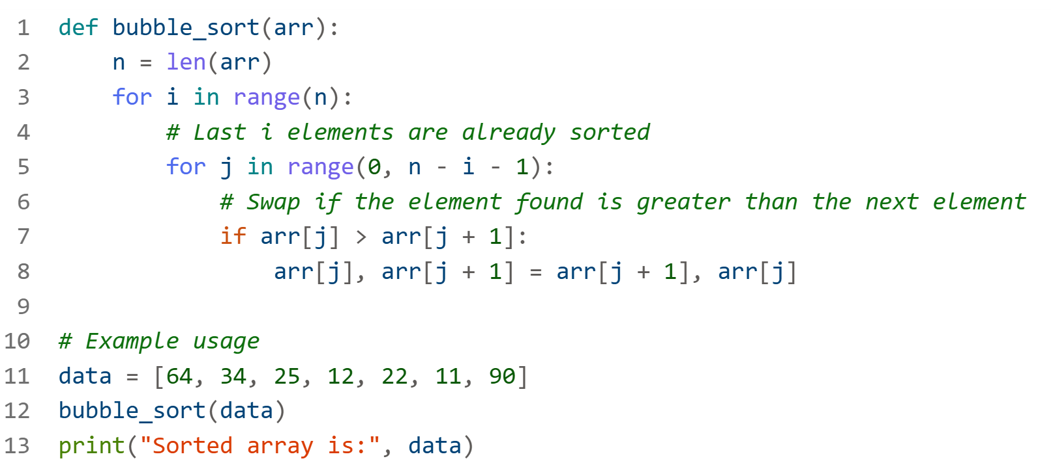
What is computer science about?
How to sort a list of numbers? How does elevator work?

Slide 3
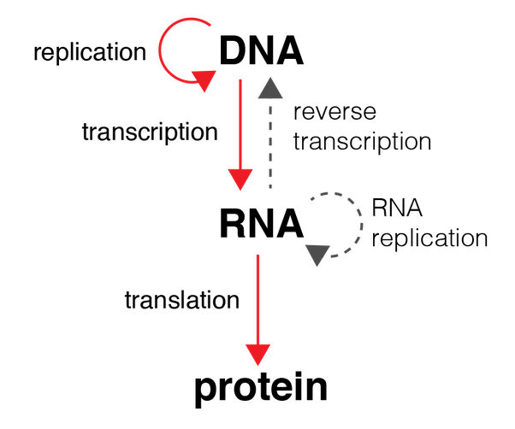
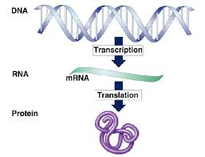
The central dogma of molecular biology

Slide 4
High Throughput Sequencing
DNA
Whole exome
Whole genome
Targeted
RNA
Bulk RNA
Poly A
Ribosome RNA depletion
scRNA
Spatial
GeoMx
Visium HD
Xenium

Slide 5
FASTA format
>chr1
ATGGTGCACCTGACTCCTGAGGAGAAGTCTGCCGTTACTGCCCTGTGGGGCAAGGTGAACGTGGATGAAGTTGGTGGTGAGGCCCTGGG…
>chr2
…
>chrM

Slide 6
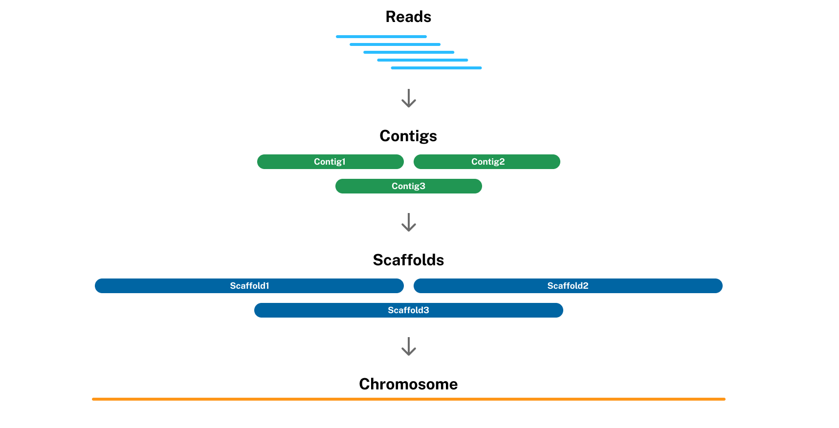
Where did the first human reference genome come from?

Slide 7
What is wrong with reference genome?
>chr1
NNNNNNNNNNNNNNNNNNNNNNNNNNNNNNNNNNNNNNATGGTGCACCTGACTCCTGAGGAGAAGTCTGCCGTTACTGCCCTGTGGGGC…
What are Ns?
Human has two alleles
Can one references truly represent all humans?
Trouble caused by “chr1”

Slide 8
FASTQ format
Line 1: Begins with @ followed by a sequence identifier (e.g., read ID)
Example: @SEQ_ID
Line 2: The nucleotide sequence (A, T, C, G, or N)
Example: GATTTGGGGTTTAAAGGG
Line 3: Begins with + and may optionally repeat the identifier
Often just +
Line 4: The ASCII-encoded quality scores, one per base in the sequence
Each character encodes the Phred quality score for the corresponding base
@SEQ_ID
GATTTGGGGTTTAAAGGG
+
!''*((((***+))%%%++
GATTTGGGGTTTNAAGGG
What is N?
Why not use integers for quality score?

Slide 9
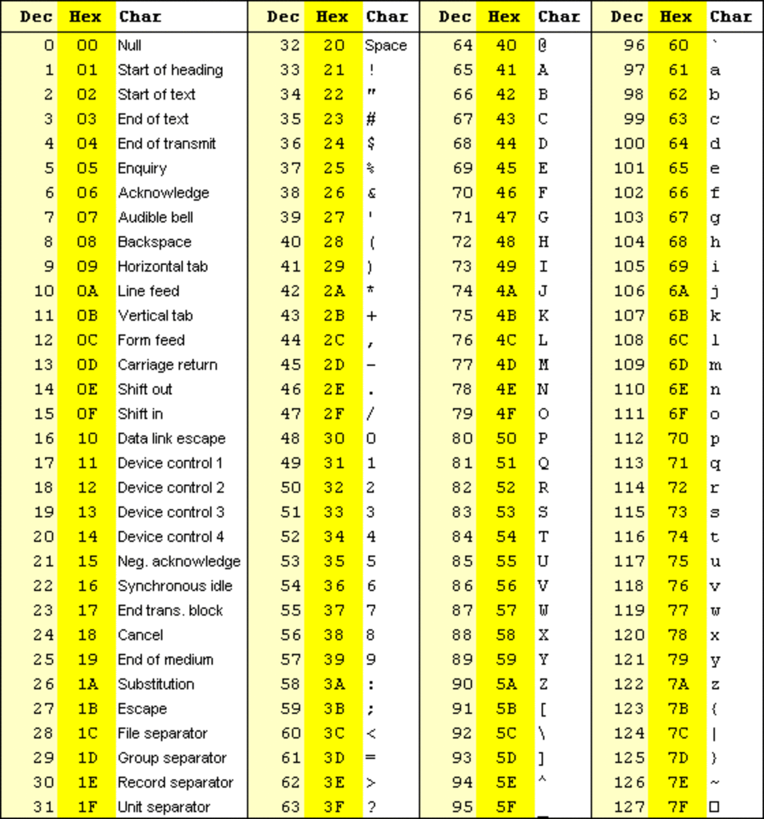
ASCII-encoded
What are the scores for ! and *

Slide 10
How to interpret Phred score
Q=−10×log10​(P)
Q = Phred score
P = Probability of base-calling error
Q = 30
Q = 30
P=10^{−Q/10}=10^{−30/10}=10⁻³=0.001

Slide 11
Quick Reference Table
Q Score | Error Rate | ASCII (Phred+33)
10 | 1 in 10 | +
20 | 1 in 100 | 5
30 | 1 in 1000 | ?
40 | 1 in 10,000 | I

Slide 12
How does the sequencer know P?
Example fluorescence intensities are:
A: 820
C: 25
G: 28
T: 30
The base caller will likely call "A".
The exact calculation formula is not known.

Slide 13
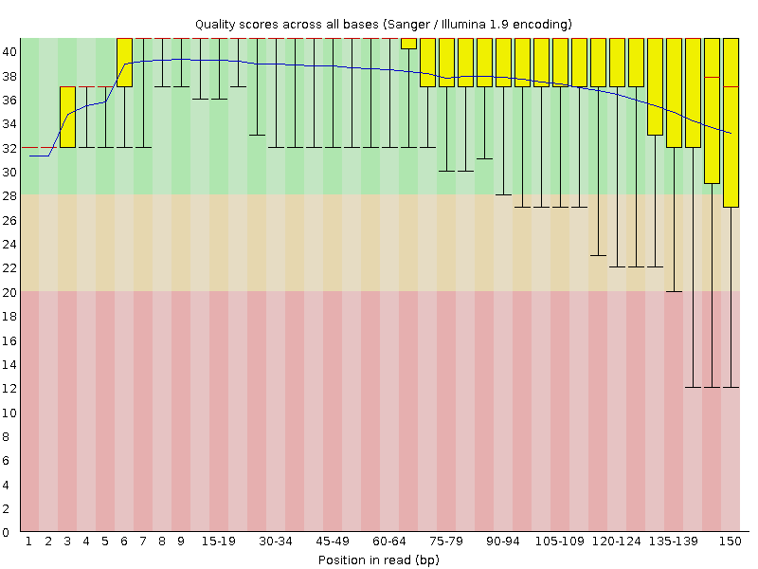
Common quality control measures

Slide 14
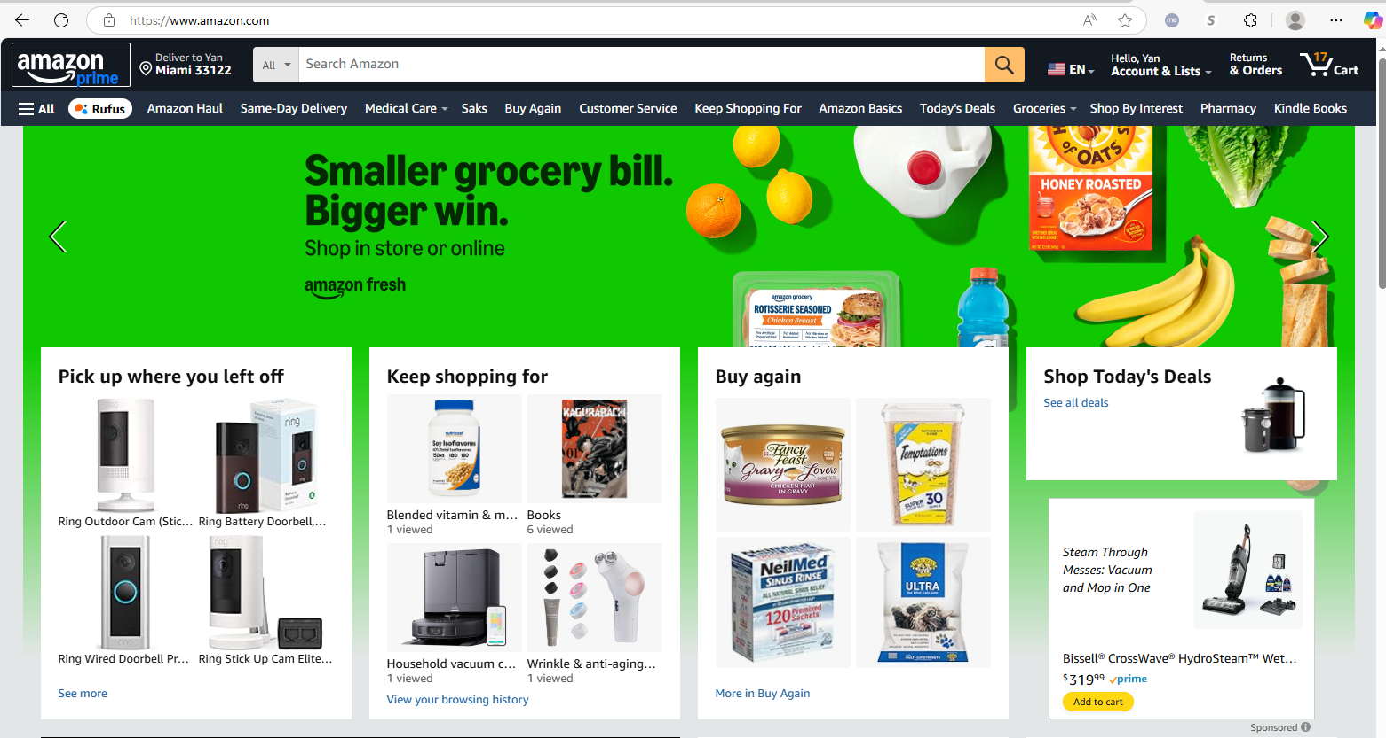
The concept of INDEX

Slide 15
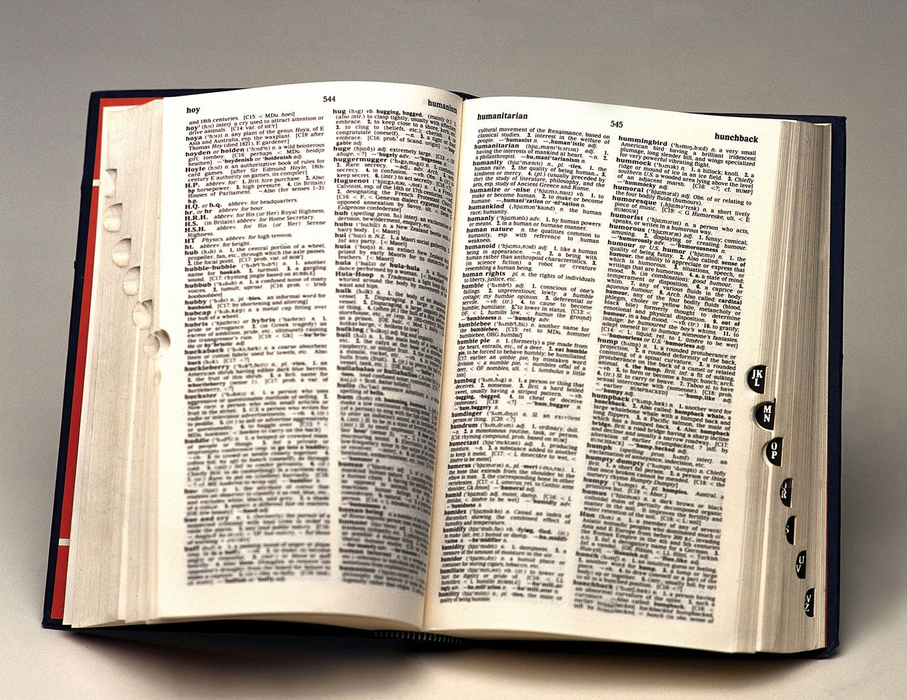
How does dictionary work
There are 171,146 English words
How would you design a digital dictionary?
Put all words into 1 array
Put all words into 26 arrays by A to Z
Any better ideas?

Slide 16
Index the dictionary
Index:
A → ["apple", "ant", "axis"]
B → ["ball", "book", "butter"]
C → ["cat", "circle", "cube"]
...
Z → ["zebra", "zone", "zoo"]

Slide 17
Tree structure
Z
A
…
O
…
A
…
O
…

Slide 18
Alignment
Which two of the following three sentences are more similar?
I ate an egg for breakfast
I ate two eggs for breakfast
You did not eat anything for dinner
Would you do this?
Read: | A | G | G | A | T
 |  | A | G | G | A | T
 |  |  | A | G | G | A | T
 |  |  |  | A | G | G | A | T
 |  |  |  |  | A | G | G | A | T
 |  |  |  |  |  | A | G | G | A | T
 |  |  |  |  |  |  | A | G | G | A | T
Reference | A | C | G | T | A | C | G | A | G | G | A | T | T | C | A | G

Slide 19
Burrows-Wheeler Transform
Cylic rotations
banana$
anana$b
nana$ba
ana$ban
na$bana
a$banan
$banana
Sort
$banana
a$banan
ana$ban
anana$b
banana$
na$bana
nana$ba
BWT("banana$") = "annb$aa"

Slide 20
Reference: TTACGA$ Read: ACG
Burrows-Wheeler Matrix
All Rotations
TTACGA$
TACGA$T
ACGA$TT
CGA$TTA
GA$TTAC
A$TTACG
$TTACGA
$TTACGA
A$TTACG
ACGA$TT
CGA$TTA
GA$TTAC
TACGA$T
TTACGA$
Last
Column
TTACGA$
Sort
BWT (T) = A G T A C T $
T

Slide 21
Reference: TTACGA$
SA (T) = = [6, 5, 2, 3, 4, 1, 0]
BWT(T) = A G T A C T $
All Rotations
Burrows-Wheeler Matrix
Suffix Array
index
0
1
2
3
4
5
6
TTACGA$
TACGA$T
ACGA$TT
CGA$TTA
GA$TTAC
A$TTACG
$TTACGA
$TTACGA
A$TTACG
ACGA$TT
CGA$TTA
GA$TTAC
TACGA$T
TTACGA$
6 $
5 A$
2 ACGA$
3 CGA$
4 GA$
1 TACGA$
0 TTACGA$
TTACGA$
Sort
T

Slide 22
Reference (T): TTACGA$ Read (W): ACG
C(a): number of characters lexicographically smaller than a in the string
For example:
$ < A < C < G < T
C($) = 0
C(A) = 1 = ($)
C(C) = 3 = ($ + A + A)
C(G) = 4 = ($ + A + A + C)
C(T) = 5 = ($ + A + A + C + G)
TTACGA$

Slide 23
Reference (T): TTACGA$ Read (W): ACG
Occ(c,i) function gives the number of times character c occurs in BWT[0..i-1]
For example:
i position | BWT | Occ($) | Occ(A) | Occ(C) | Occ(G) | Occ(T)
0 | A | 0 | 0 | 0 | 0 | 0
1 | G | 0 | 1 | 0 | 0 | 0
2 | T | 0 | 1 | 0 | 1 | 0
3 | A | 0 | 1 | 0 | 1 | 1
4 | C | 0 | 2 | 0 | 1 | 1
5 | T | 0 | 2 | 1 | 1 | 1
6 | $ | 0 | 2 | 1 | 1 | 2
7 | - | 1 | 2 | 1 | 1 | 2
BWT(T) = A G T A C T $
Occ(A,4): number of A’s in BWT[0..3] = 2
Occ(G,2): number of G’s in BWT[0..1] = 1

Slide 24
Reference (T): TTACGA$ Read (W): ACG
C(c)
$ < A < C < G < T
C($) = 0
C(A) = 1 = ($)
C(C) = 3 = ($ + A + A)
C(G) = 4 = ($ + A + A + C)
C(T) = 5 = ($ + A + A + C + G)
Backward Search:
start_inital = C(X) , end_inital = C(X+1)
New_range_start = C(c) + Occ(c, old_range_start)
New_range_end = C(c) + Occ(c, old_range_end + 1) - 1
Occ
i | BWT | Occ($) | Occ(A) | Occ(C) | Occ(G) | Occ(T)
0 | A | 0 | 0 | 0 | 0 | 0
1 | G | 0 | 1 | 0 | 0 | 0
2 | T | 0 | 1 | 0 | 1 | 0
3 | A | 0 | 1 | 0 | 1 | 1
4 | C | 0 | 2 | 0 | 1 | 1
5 | T | 0 | 2 | 1 | 1 | 1
6 | $ | 0 | 2 | 1 | 1 | 2
7 | - | 1 | 2 | 1 | 1 | 2
For example:
(1) Search G:
C(G) = 4
start_inital = C(G) = 4
end_inital = C(T) = 5
Range = [4, 5]
BWT(T) = A G T A C T $

Slide 25
Reference (T): TTACGA$ Read (W): ACG
C(c)
$ < A < C < G < T
C($) = 0
C(A) = 1 = ($)
C(C) = 3 = ($ + A + A)
C(G) = 4 = ($ + A + A + C)
C(T) = 5 = ($ + A + A + C + G)
Backward Search:
New_range_start = C(c) + Occ(c, old_range_start)
New_range_end = C(c) + Occ(c, old_range_end + 1) - 1
Occ
For example:
(1) Range = [4, 5]
(2) Search C:
C(C) = 3
Occ(C, 4) = 0
Occ(C, 5+1) = 1
Range = [3+ Occ(C,4), 3 + Occ(C,5+1) -1] = [3, 3]
i | BWT | Occ($) | Occ(A) | Occ(C) | Occ(G) | Occ(T)
0 | A | 0 | 0 | 0 | 0 | 0
1 | G | 0 | 1 | 0 | 0 | 0
2 | T | 0 | 1 | 0 | 1 | 0
3 | A | 0 | 1 | 0 | 1 | 1
4 | C | 0 | 2 | 0 | 1 | 1
5 | T | 0 | 2 | 1 | 1 | 1
6 | $ | 0 | 2 | 1 | 1 | 2
7 | - | 1 | 2 | 1 | 1 | 2
BWT(T) = A G T A C T $

Slide 26
Reference (T): TTACGA$ Read (W): ACG
C(c)
$ < A < C < G < T
C($) = 0
C(A) = 1 = ($)
C(C) = 3 = ($ + A + A)
C(G) = 4 = ($ + A + A + C)
C(T) = 5 = ($ + A + A + C + G)
Backward Search:
New_range_start = C(c) + Occ(c, old_range_start)
New_range_end = C(c) + Occ(c, old_range_end + 1) - 1
Occ
For example:
(2) Range = [3, 3]
(3) Search A:
C(A) = 1
Occ(A, 3) = 1
Occ(A, 3+1) = 2
Range = [1+ Occ(A,3), 1 + Occ(A,3 +1) -1] = [2, 2]
i | BWT | Occ($) | Occ(A) | Occ(C) | Occ(G) | Occ(T)
0 | A | 0 | 0 | 0 | 0 | 0
1 | G | 0 | 1 | 0 | 0 | 0
2 | T | 0 | 1 | 0 | 1 | 0
3 | A | 0 | 1 | 0 | 1 | 1
4 | C | 0 | 2 | 0 | 1 | 1
5 | T | 0 | 2 | 1 | 1 | 1
6 | $ | 0 | 2 | 1 | 1 | 2
7 | - | 1 | 2 | 1 | 1 | 2
BWT(T) = A G T A C T $

Slide 27
Reference (T): TTACGA $ Read (W): ACG
Range = [1+ Occ(A,3), 1 + Occ(A,3 +1) -1] = [2, 2]
SA (T) = = [6, 5, 2, 3, 4, 1, 0]
Suffix Array
index
0
1
2
3
4
5
6
T
T
A
C
G
A
$
6 $
5 A$
2 ACGA$
3 CGA$
4 GA$
1 TACGA$
0 TTACGA$
TTACGA$
T
TTACGA
ACG

Slide 28
Result
The final range [2, 3) corresponds to 1 position in the suffix array: SA[2] = 2
This means the read ACG matches the reference starting at position 1 (0-based index)

Slide 29
SAM/BAM/CRAM format
SAM: Sequencing Alignment Map
BAM: Binary Alignment Map
CRAM: Compressed BAM

Slide 30
BAM
Field | Name | Description
1 | QNAME | Query name of the read (e.g., read ID)
2 | FLAG | Bitwise flag indicating read properties (e.g., paired, mapped, reverse strand)
3 | RNAME | Reference sequence name (e.g., chromosome)
4 | POS | 1-based leftmost mapping position
5 | MAPQ | Mapping quality (Phred-scaled)
6 | CIGAR | CIGAR string describing alignment (e.g., 76M for 76 matches)
7 | RNEXT | Reference name of the mate/next read
8 | PNEXT | Position of the mate/next read
9 | TLEN | Observed template length
10 | SEQ | Segment sequence
11 | QUAL | ASCII of Phred-scaled base quality + 33

Slide 31
BAM - FLAG
Bit (Decimal) | Hex | Description
0x1 (1) | 0x1 | Read is paired in sequencing
0x2 (2) | 0x2 | Read is mapped in a proper pair
0x4 (4) | 0x4 | Read is unmapped
0x8 (8) | 0x8 | Mate is unmapped
0x10 (16) | 0x10 | Read is mapped to the reverse strand
0x20 (32) | 0x20 | Mate is mapped to the reverse strand
0x40 (64) | 0x40 | Read is the first in a pair
0x80 (128) | 0x80 | Read is the second in a pair
0x100 (256) | 0x100 | Read is not primary alignment
0x200 (512) | 0x200 | Read fails platform/vendor quality checks
0x400 (1024) | 0x400 | Read is a PCR or optical duplicate
0x800 (2048) | 0x800 | Read is supplementary alignment (e.g., split read)

Slide 32
BAM - CICAR
What do they mean?
150M
100M1I49M
149M1S
Symbol | Meaning
M | Alignment match (can be match or mismatch)
= | Sequence match (exact match)
X | Sequence mismatch
I | Insertion to the reference
D | Deletion from the reference
N | Skipped region from the reference (e.g., intron)
S | Soft clipping (read bases not aligned but present in SEQ)
H | Hard clipping (read bases not present in SEQ)
P | Padding (silent deletion from padded reference)

Slide 33
Pair end reads and RNEXT
5’-ATGCCGTAG…CTAGGCTACGA-3’
3’-TACGGCATC…GATCCGATGCT-5’
A read is always sequenced from 5’ to 3’
RNEXT can be used to check library size selection quality

Slide 34
Alignment example
First, copy the example folder to your own home directory with this command:
cp -r /home/yan/Tutorial_alignment/ .
After this command, you should have the Tutorial_alignment folder in your home directory.
In there, there is a README file, please follow the README file to finish the alignment example.

Slide 35
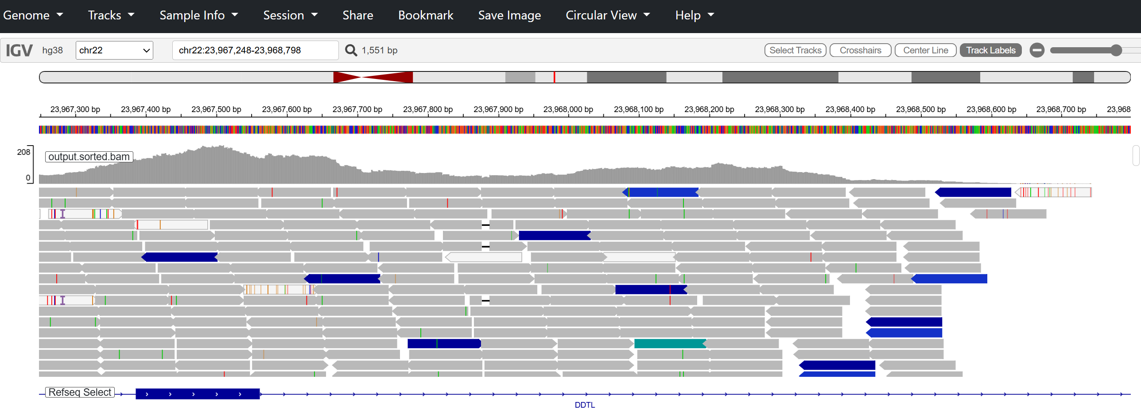
IGV

Slide 36
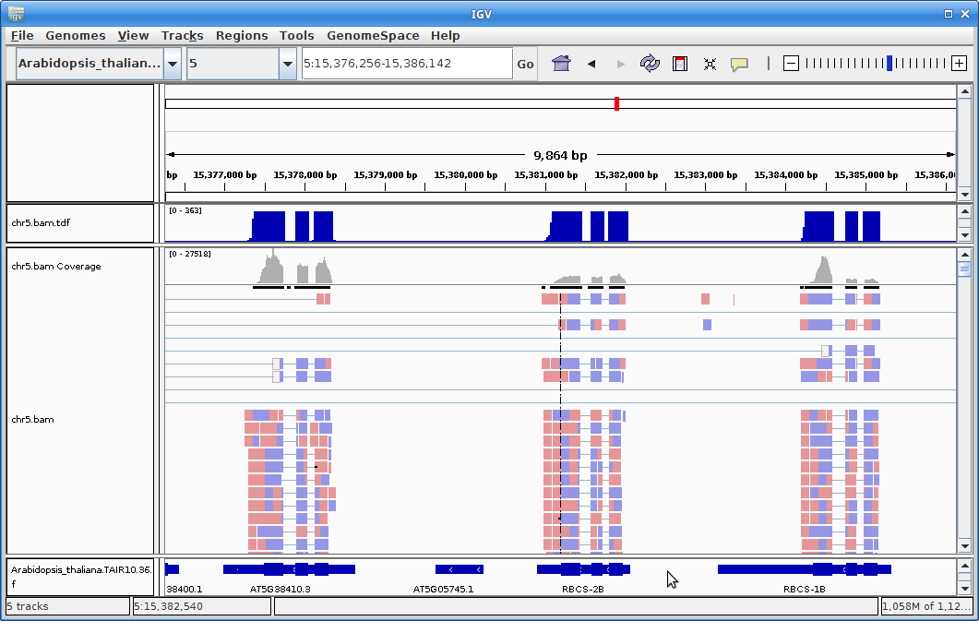
IGV RNA-seq

Slide 37
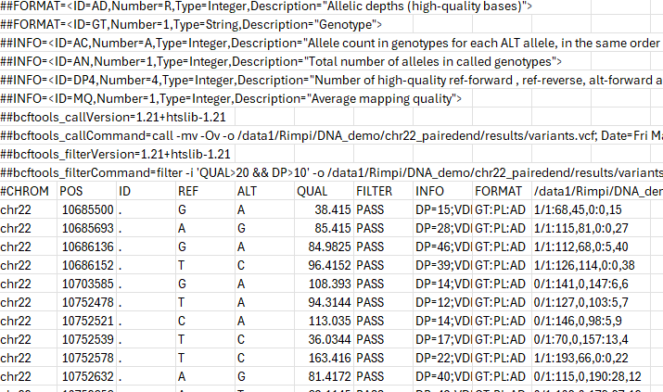
VCF format

Slide 38
Type of mutations
Germline mutations
Somatic mutations
De Novo mutations
Structural mutations
Small indel
Large indel
Duplication
Inversion
Translocation
Gene fusion

Slide 39
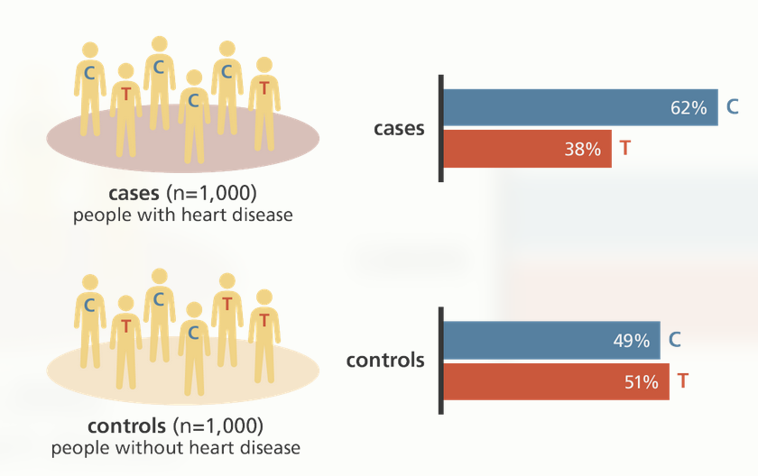


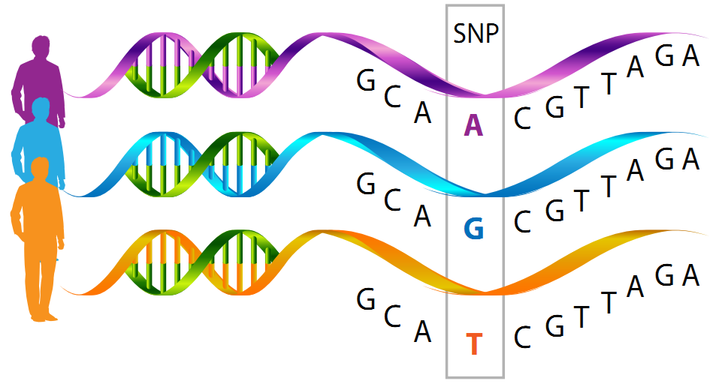
SNP application - GWAS
What are Genotypes and SNPs?
AC
GG
http://www.yourgenome.org/stories/genome-wide-association-studies
AG
CG
Genotype: individual
SNP: population
In one individual, at one genomic position.
There are only three possible genotypes:
00, 01, 11
http://biogeniq.ca/en/snp/

Slide 40
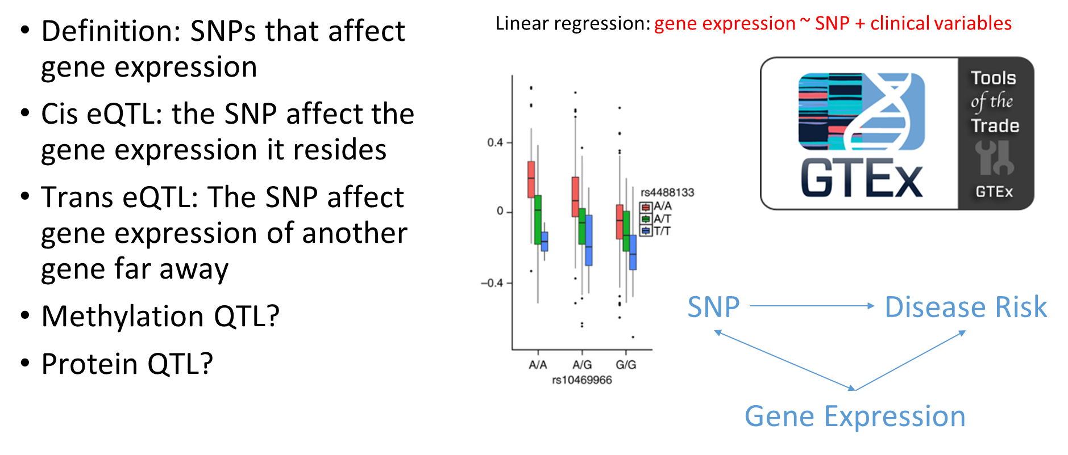
SNP application – eQTL

Slide 41
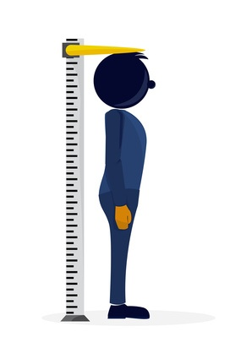

SNP application – Mendelian randomization
The phenotype variables we measured are usually confounded by environment
Logistic regression: disease (0,1) ~ height
Confounding
Environment
Genetic Height
Measured Height

Slide 42
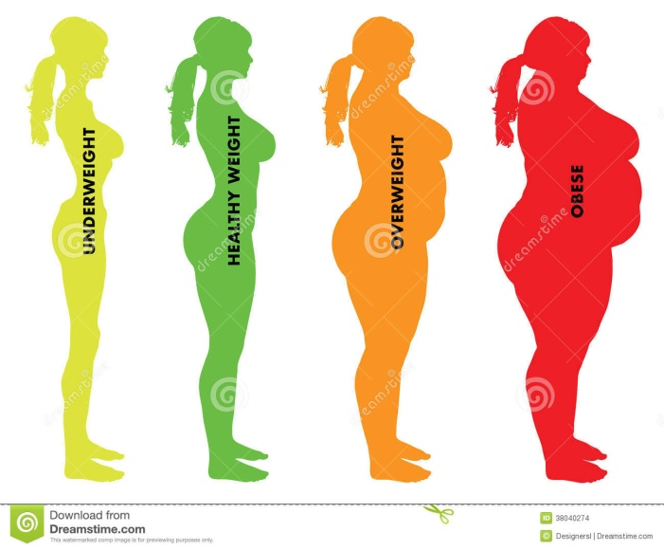
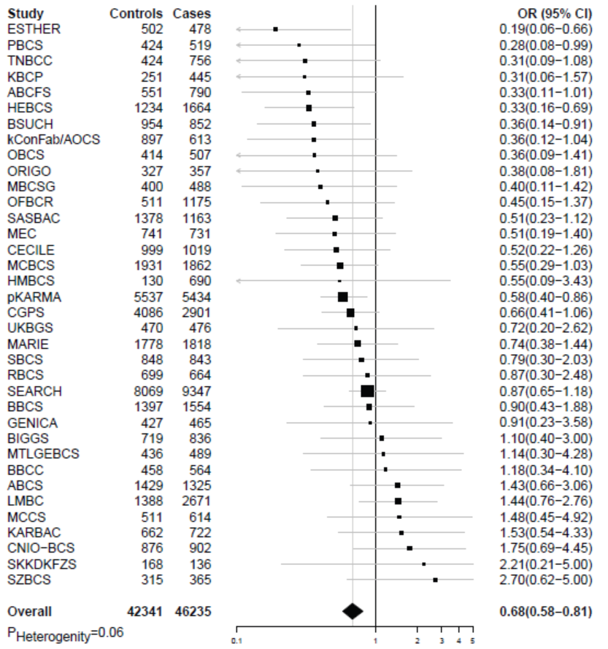
BMI and Breast Cancer Risk
Measured BMI
Breast Cancer Risk
Genetic BMI / GRS
Breast Cancer Risk
PLOS Medicine, 2016

Slide 43
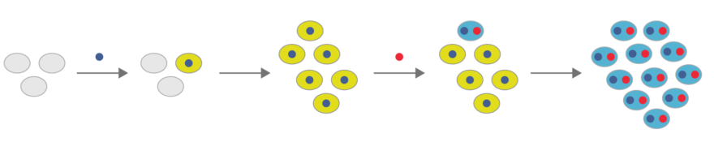
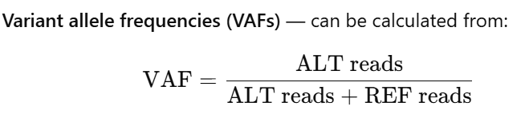
Somatic mutation application - clonal history

Slide 44
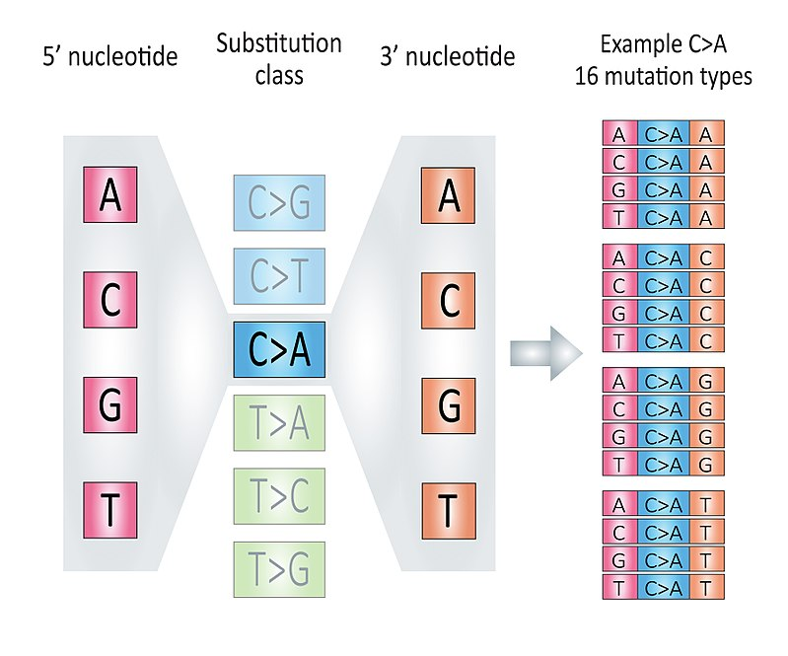
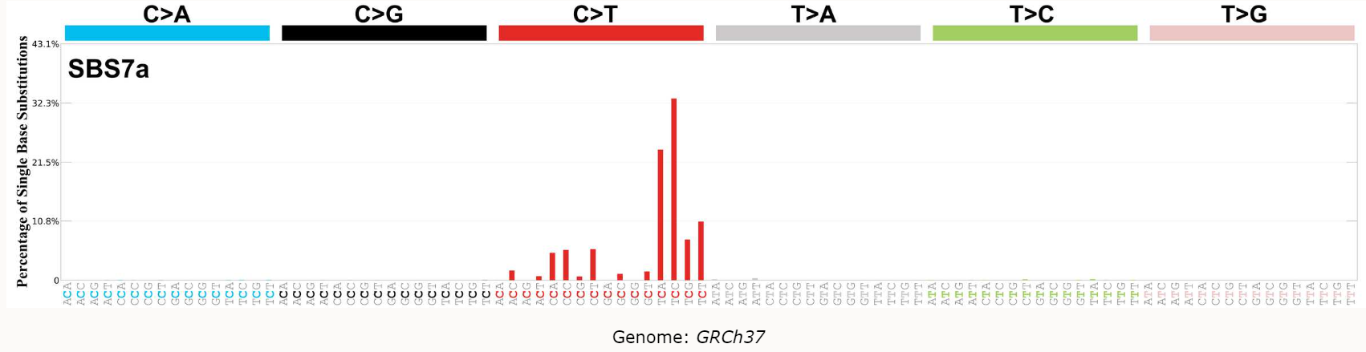
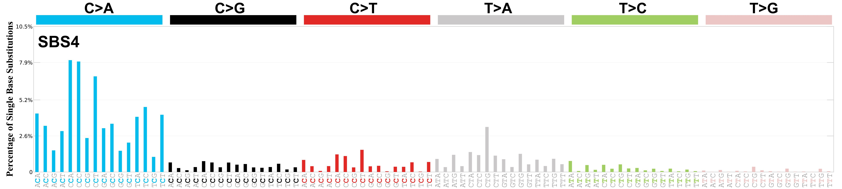
Mutational Signature
SBS7a: UV exposure
SBS4: Tobacco use

Slide 45
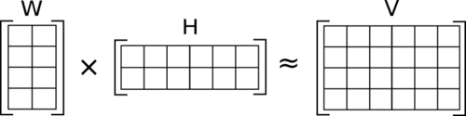
Somatic mutation application – Mutational Signature (Deconvolution)
Non-negative matrix factorization
V is the original data matrix of shape in m x n
W is the basis matrix of shape m x k
H is a coefficient matrix of shape k x n
In V, each column is a sample, the value of each row is approximated as a non-negative linear combination of basis components in W, weighted by H

Slide 46
V is a 96 x n matrix, n is number of samples
Row = 96, each row denotes a 3-nucleotide motif
n is number of samples
W is a 96 x k matrix, it serves as a reference
Row = 96, each row denotes trinucleotide patterns
k is the number of known mutational signatures in the reference
H is a k x n result matrix
k is the number of mutational signatures in the reference matrix
n is the number of samples in V

